Slide 1
Welcome
Joe Nelson
@begriffs
Brian Lonsdorf
@drboolean

Slide 2
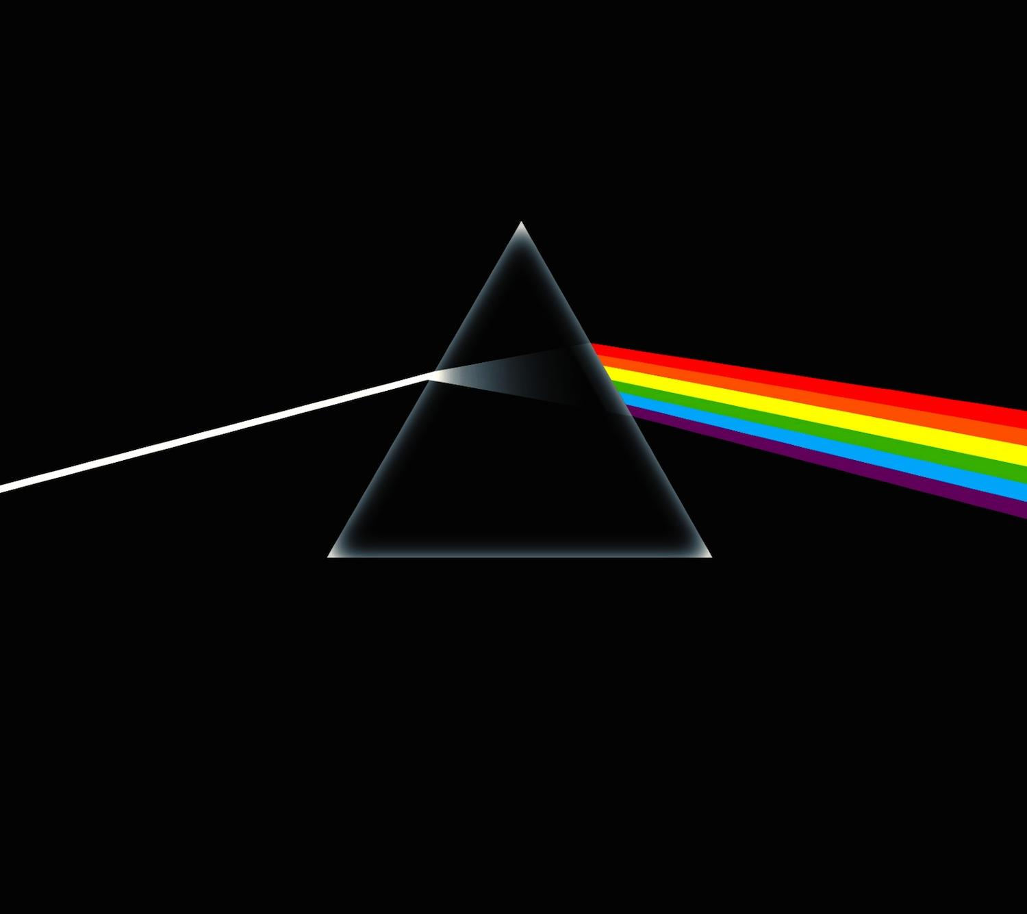
Separation and Recognition
The Soul of Functional Programming

Slide 3
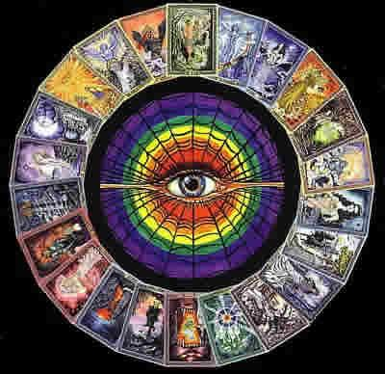
I: The Silence
III: The Demo
II: The Voyage

Slide 4
In the Beginning...
there was primordial soup
10 i = 020 i = i + 130 PRINT i; " squared = "; i * i40 IF i >= 10 THEN GOTO 6050 GOTO 2060 PRINT "Program Completed."70 END
• Anything goes
• Everything changes
• Weird names

Slide 5
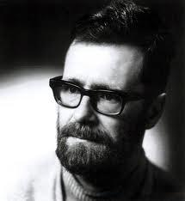
Discipline Wins
Exercising restraint while coding feels weird at first, but it’s worth it.
“The goto statement as it stands is just too primitive; it is too much an invitation to make a mess of one's program.”

Slide 6
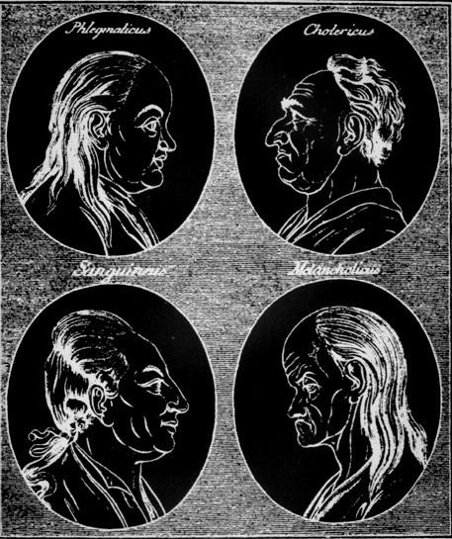
The Symptoms
Custom names
Looping patterns
Glue code
Side effects

Slide 8
Omit Needless
Names
with separations
and recognitions

Slide 9
separate inputs from environment
Secret input: time
Always works the same
function daysThisMonth() { var date = new Date() , y = date.getFullYear() , m = date.getMonth() , start = new Date(y, m, 1) , end = new Date(y, m + 1, 1); return (end - start) / (1000 * 60 * 60 * 24); }
function daysInMonth(y, m) { var start = new Date(y, m - 1, 1) , end = new Date(y, m, 1); return (end - start) / (1000 * 60 * 60 * 24); }
jsbin.com/yoyip
Notes:
More testable and also portable. E.g. can’t access window from Node.

Slide 10
separate mutation from calculation
Teaser updates DOM
Merely calculates
function teaser(size, elt) { setText(elt, slice(0, size, text(elt))); } map(teaser(50), all('p'));
var teaser = slice(0); map(compose(setText, teaser(50), text), all('p'));
Mutation
Mutation

Slide 11
recognize pure functions
Functions that don’t change anything are called “pure.”
Their purity makes them
testable
portable
memoizable
parallelizable

Slide 12
Let’s play pure or impure
function getQueryVariable(variable) { var query = window.location.search.substring(1); var vars = query.split('&'); for (var i = 0; i < vars.length; i++) { var pair = vars[i].split('='); if (decodeURIComponent(pair[0]) == variable) { return decodeURIComponent(pair[1]); } } }

Slide 13
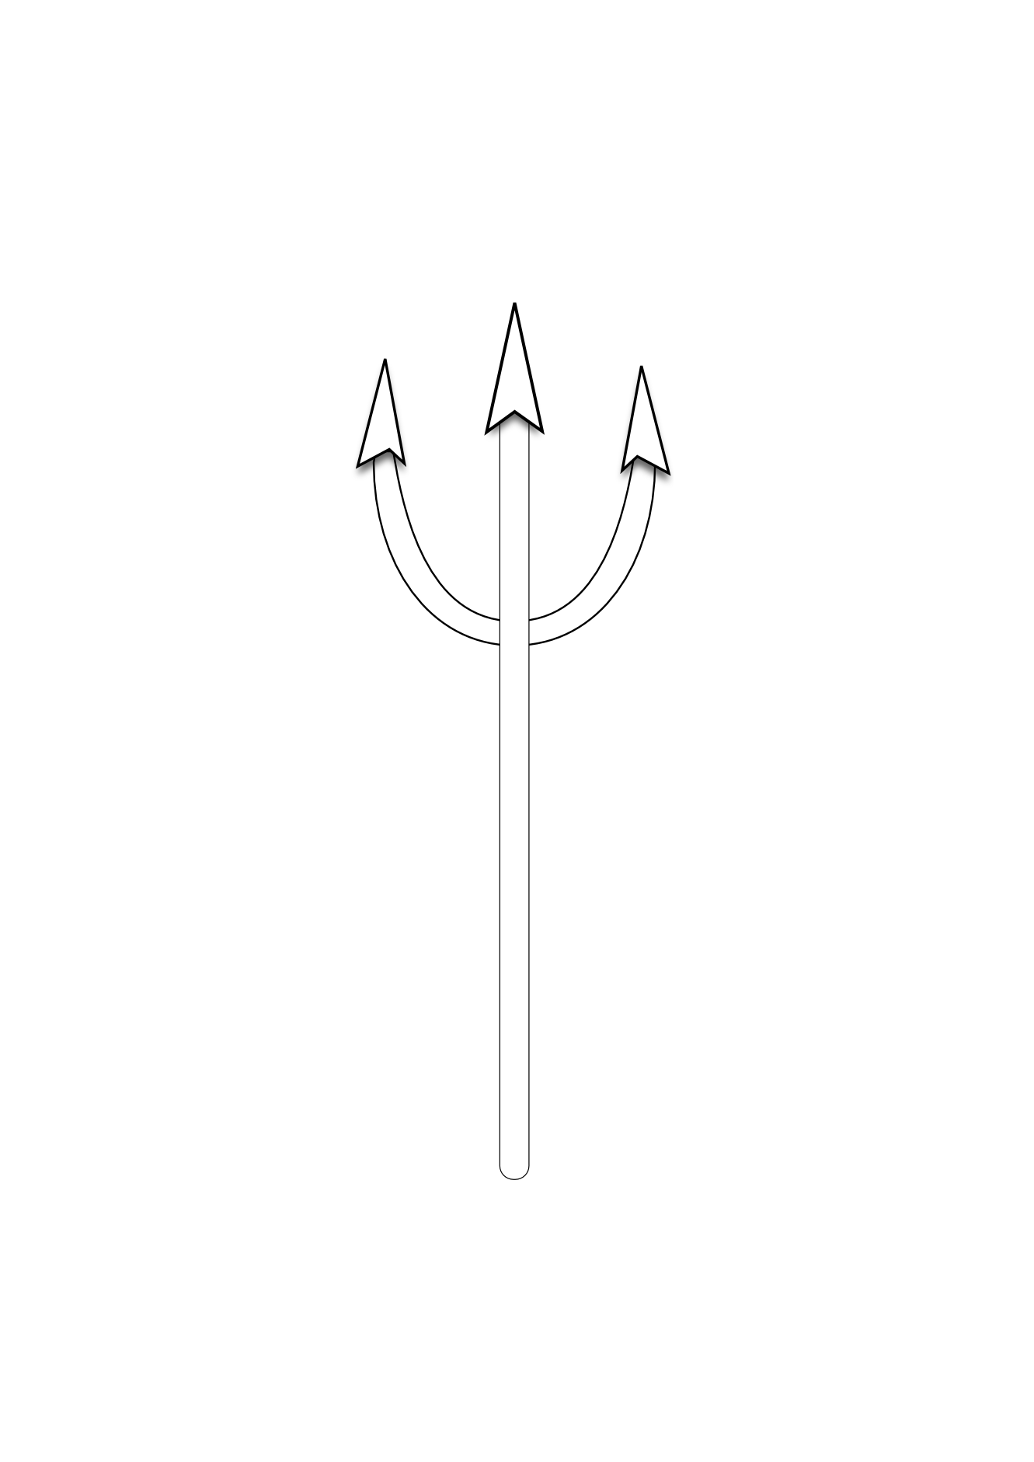
Let’s play pure or impure
function random(m_w, m_z) { m_z = 36969 * (m_z & 65535) + (m_z >> 16); m_w = 18000 * (m_w & 65535) + (m_w >> 16); return (m_z << 16) + m_w; }

Slide 14
Let’s play pure or impure
function chattyAdd(a, b, console) { var c = a+b; console.log(a, '+', b, '=', c); return c; }

Slide 15
separate functions from rules
functions are nouns

Slide 16
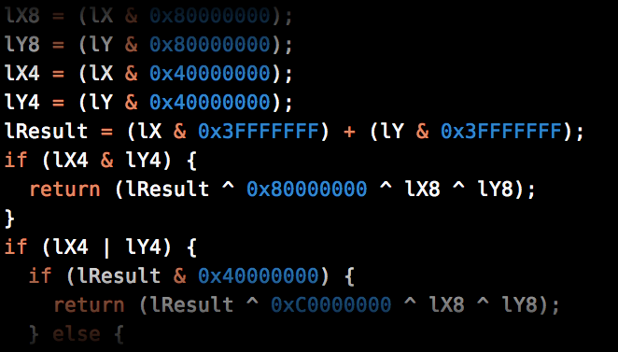
separate functions from rules
Intension
strings | 8cab5c3f5106aa48299dec51e77921ad
are | eacbe4d1b2dee530eee7460477877c4d
strung | 1c6509708e542c4f27d4437b15e331cd
Extension

Slide 17
Set theoretically
Every function is
a single-valued collection of pairs
THIS
NOT THIS
...
(-2, -1)
(0 , 0 )
(2 , 1 )
(4 , 2 )
(8 , 4 )
...
(1, D)
(2, B)
(2, C)

Slide 18
One input, one output
...
(-2, -1)
(0 , 0 )
(2 , 1 )
(4 , 2 )
(8 , 4 )
...
Domain
Range
… -2 0 2 4 8 ...
… -1 0 1 2 4 ...

Slide 19
Pulling it into JS

Slide 20
separate arity from functions
function get(property, object) { return object[property]; }
var people = [ {name: ...}, ... ];
Args up front
More args later
function getPersonName(person) { return get('name', person); }var names = people.map(getPersonName);
// ☆☆ MAGIC! ☆☆
var names = people.map(get('name'));

Slide 21
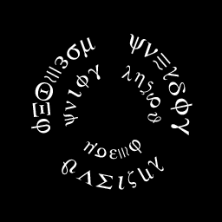
01 function curry(fn) {02 return function() {03 if (fn.length > arguments.length) {04 var slice = Array.prototype.slice;05 var args = slice.apply(arguments);06 return function() {07 return fn.apply(08 null, args.concat(slice.apply(arguments)));09 };10 }11 return fn.apply(null, arguments);12 };13 }

Slide 22
Our code becomes
var get = curry(function (property, object) { return object[property]; });
var names = people.map(get('name'));
jsbin.com/romun
answers: http://jsbin.com/huqif

Slide 23
Example currying
var words = function(str) { return split(' ', str); }; words("Jingle bells Batman smells");//=> ['Jingle', 'bells', 'Batman', 'smells']
var words = split(' '); words("Jingle bells Batman smells");//=> ['Jingle', 'bells', 'Batman', 'smells']

Slide 24
Example currying
var greater = function(x,y){ return x > y ? x : y; };
var max = function(xs) { return reduce(greater, -Infinity, xs); };
max([323,523,554,123,5234])//=> 5234
var max = reduce(greater, -Infinity)
max([323,523,554,123,5234])//=> 5234
Notes:
Notice that reduce, not greater, is not curried.

Slide 25
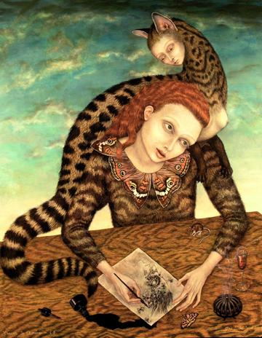
Back to weird noun-function land

Slide 26
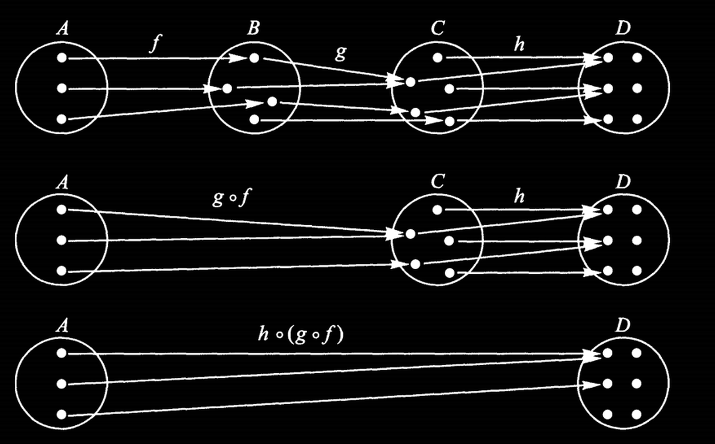
functions can “meld” aka compose

Slide 27
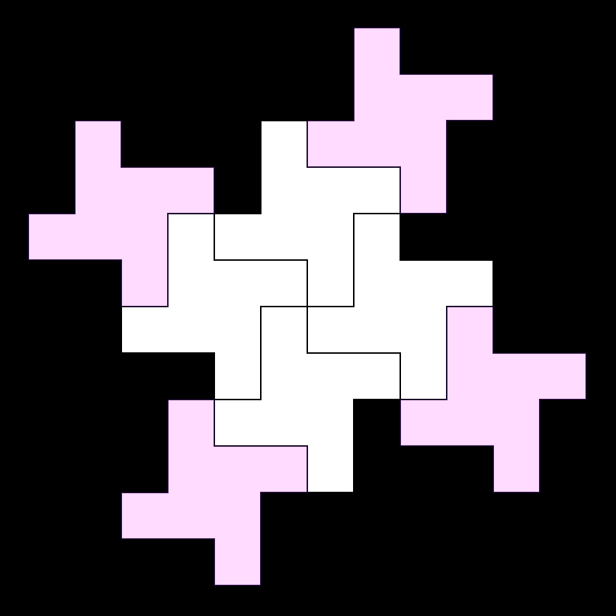
Aside: categories
Zooming way out from code
You start seeing similarities
Pure functions are the arrows of a “category”
Brian will show you more in The Journey

Slide 28
separate composition from args
Javascript code composes functions all the time
But too often it uses unnecessary arguments

Slide 29
example “glue” names
To compose the logging and message extraction we created a function and a “glue” name called error.
on_error(function(error) { log(error.message); });

Slide 30
Simplified compose function
function compose(g, f) { return function(x) { return g(f(x)); }; }
This function does not care what is inside f or g. It produces a new function that pushes a value through.
“olleH” ← “Hello” ← “hello”
compose( reverse, properNoun )

Slide 31
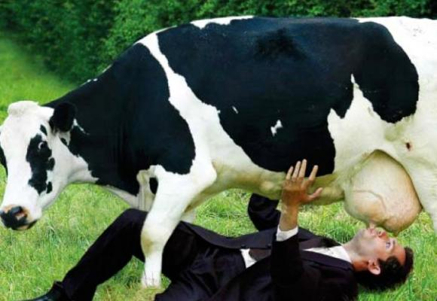
Cut out the middle man
on_error( compose(log, get('message')) );

Slide 32
Cut out the middle man
on_error( compose(log, get('message')) );
jsbin.com/jevag
answers: http://jsbin.com/lutug
(sorry)

Slide 33
recognize most loops are one of
reduce
filter
map

Slide 34
If you write a loop you get an F !
Loops

Slide 35
In review...
Make all function inputs explicit as arguments.
These arguments can be provided over time, not just all at once.
Try not to modify outside things.
Compose without “glue” variables.

Slide 36
End of Part I
The Silence

Slide 37
Part II
The Voyage

Slide 38
add(1, 1)//=> 2
Notes:
Bored? bitly for cata

Slide 39
// associativeadd(add(1, 2), 4) == add(1, add(2, 4))// commutativeadd(4, 1) == add(1, 4)// identityadd(n, 0) == n// distributive multiply(2, add(3,4)) == add(multiply(2, 3), multiply(2, 4))
Notes:
Bored? bitly for cata

Slide 40
add("ta", "cos")//=> tacosadd(9.2, 0.5)//=> 9.7add([1,2,3], [4,5,6])//=> [1,2,3,4,5,6]
Notes:
Bored? bitly for cata

Slide 41
Category Theory
compose :: (b -> c) -> (a -> b) -> (a -> c) id :: a -> a

Slide 42
Category Laws
// left identity compose(id, f) == f// right identity compose(f, id) == f// associativity compose(compose(f, g), h) == compose(f, compose(g, h))

Slide 43
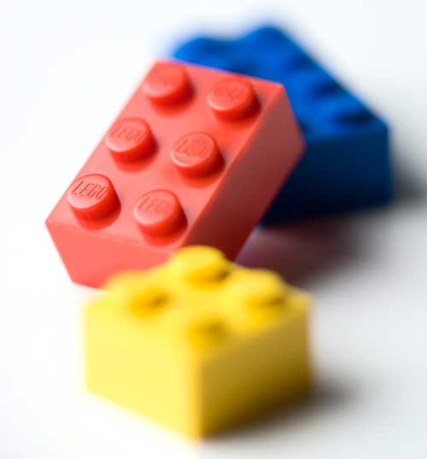

Slide 44
Nulls

Slide 45
Nulls
Callbacks

Slide 46
Nulls
Callbacks
Errors

Slide 47
Nulls
Callbacks
Errors
Side effects

Slide 48
Objects
Containers/Wrappers for values
No methods
Not nouns
Probably won’t be making your own often
*think of it this way for now.

Slide 49
Objects
var _Container = function(val) { this.val = val; }var Container = function(x) { return new _Container(x); };
Container(3)
//=> _Container {val: 3}
Notes:
Bored? bitly for cata

Slide 50
Objects
capitalize("flamethrower")//=> "Flamethrower"
capitalize(Container("flamethrower"))
//=> [object Object]
Notes:
Bored? bitly for cata

Slide 51
Objects
var _Container.prototype.map = function(f) { return Container(f(this.val)); } Container("flamethrower").map(function(s){ return capitalize(s) })
//=> Container(“Flamethrower”)
Notes:
Bored? bitly for cata

Slide 52
Objects
var _Container.prototype.map = function(f) { return Container(f(this.val)); } Container("flamethrower").map(capitalize)
//=> Container(“Flamethrower”)
Notes:
Bored? bitly for cata

Slide 53
Objects
Container(3).map(add(1))
//=> Container(4)
[3].map(add(1))
//=> [4]
Notes:
Bored? bitly for cata

Slide 54
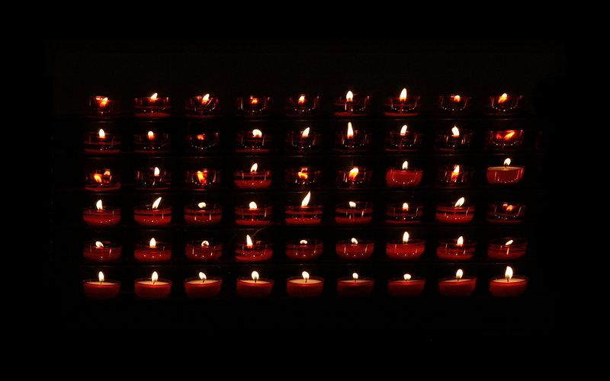
the true map
goes within

Slide 55
Objects
Container([1,2,3]).map(reverse).map(first)//=> Container(3)
Container("flamethrower").map(length).map(add(1))
//=> Container(13)
Notes:
Bored? bitly for cata

Slide 56
Objects
var map = _.curry(function(f, obj) { return obj.map(f) })
Container(3).map(add(1)) // Container(4)
map(add(1), Container(3)) // Container(4)
Notes:
Bored? bitly for cata

Slide 57
Objects
map(match(/cat/g), Container("catsup"))
//=> Container([“cat”])
map(compose(first, reverse), Container("dog"))
//=> Container(“g”)
Notes:
Bored? bitly for cata

Slide 58
Functor
“An object or data structure you can map over”
functions: map

Slide 59
Them pesky nulls
var getElement = document.querySelectorvar getNameParts = compose(split(' '), get('value'), getElement) getNameParts('#full_name')//=> ['Jonathan', 'Gregory', 'Brandis']
Notes:
Bored? bitly for cata

Slide 60
Them pesky nulls
var getElement = document.querySelectorvar getNameParts = compose(split(' '), get('value'), getElement) getNameParts('#fullname')//=> Boom!
Notes:
Bored? bitly for cata

Slide 61
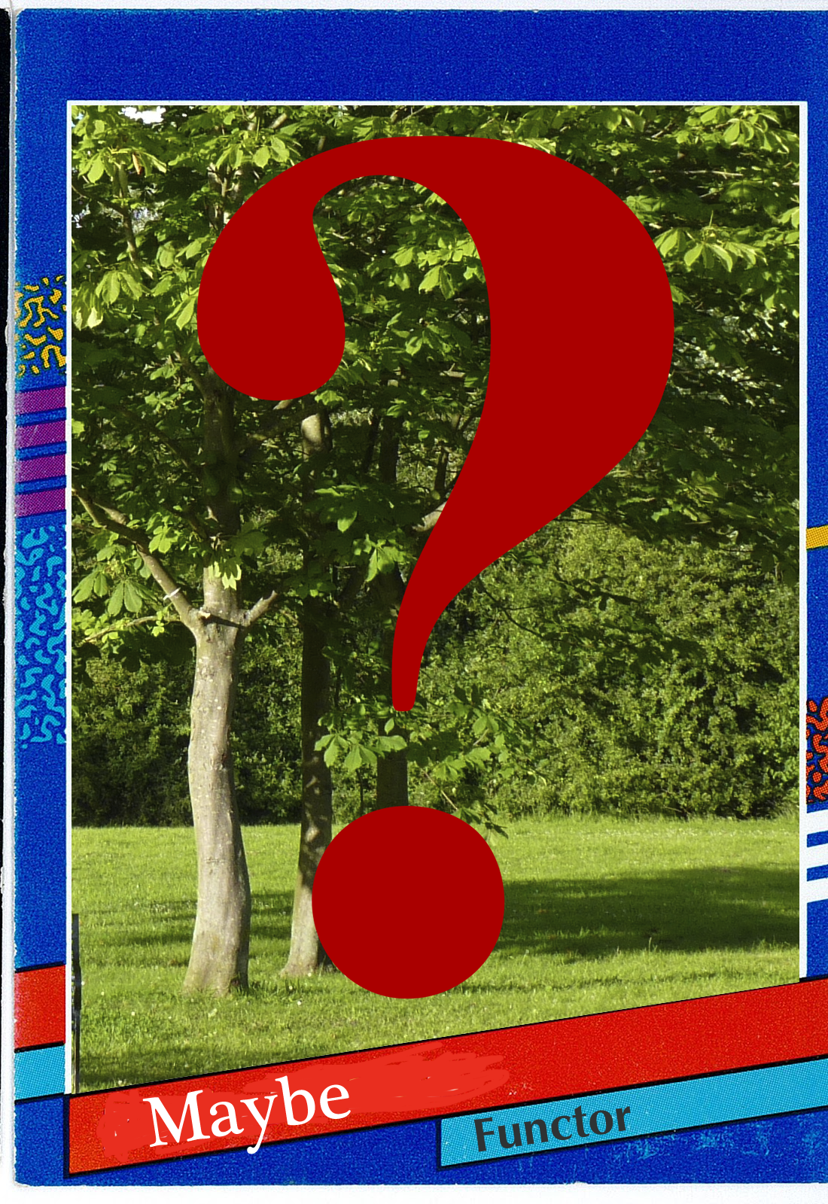
Maybe
Captures a null check
The value inside may not be there
Sometimes has two subclasses Just / Nothing
Sometimes called Option with subclasses Some/None
Notes:
Bored? bitly for cata

Slide 62
Maybe
var _Maybe.prototype.map = function(f) { return this.val ? Maybe(f(this.val)) : Maybe(null); }
map(capitalize, Maybe("flamethrower"))//=> Maybe(“Flamethrower”)
Notes:
Bored? bitly for cata

Slide 63
Maybe
var _Maybe.prototype.map = function(f) { return this.val ? Maybe(f(this.val)) : Maybe(null); }
map(capitalize, Maybe(null))//=> Maybe(null)
Notes:
Bored? bitly for cata

Slide 64
Maybe
var firstMatch = compose(first, match(/cat/g))
firstMatch("dogsup")//=> Boom!
Notes:
Bored? bitly for cata

Slide 65
Maybe
var firstMatch = compose(map(first), Maybe, match(/cat/g))
firstMatch("dogsup")//=> Maybe(null)
Notes:
Bored? bitly for cata

Slide 66
Maybe
var firstMatch = compose(map(first), Maybe, match(/cat/g))
firstMatch("catsup")//=> Maybe(“cat”)
http://jsbin.com/yumog/
answers: http://jsbin.com/sopewomi
Notes:
Bored? bitly for cata

Slide 67
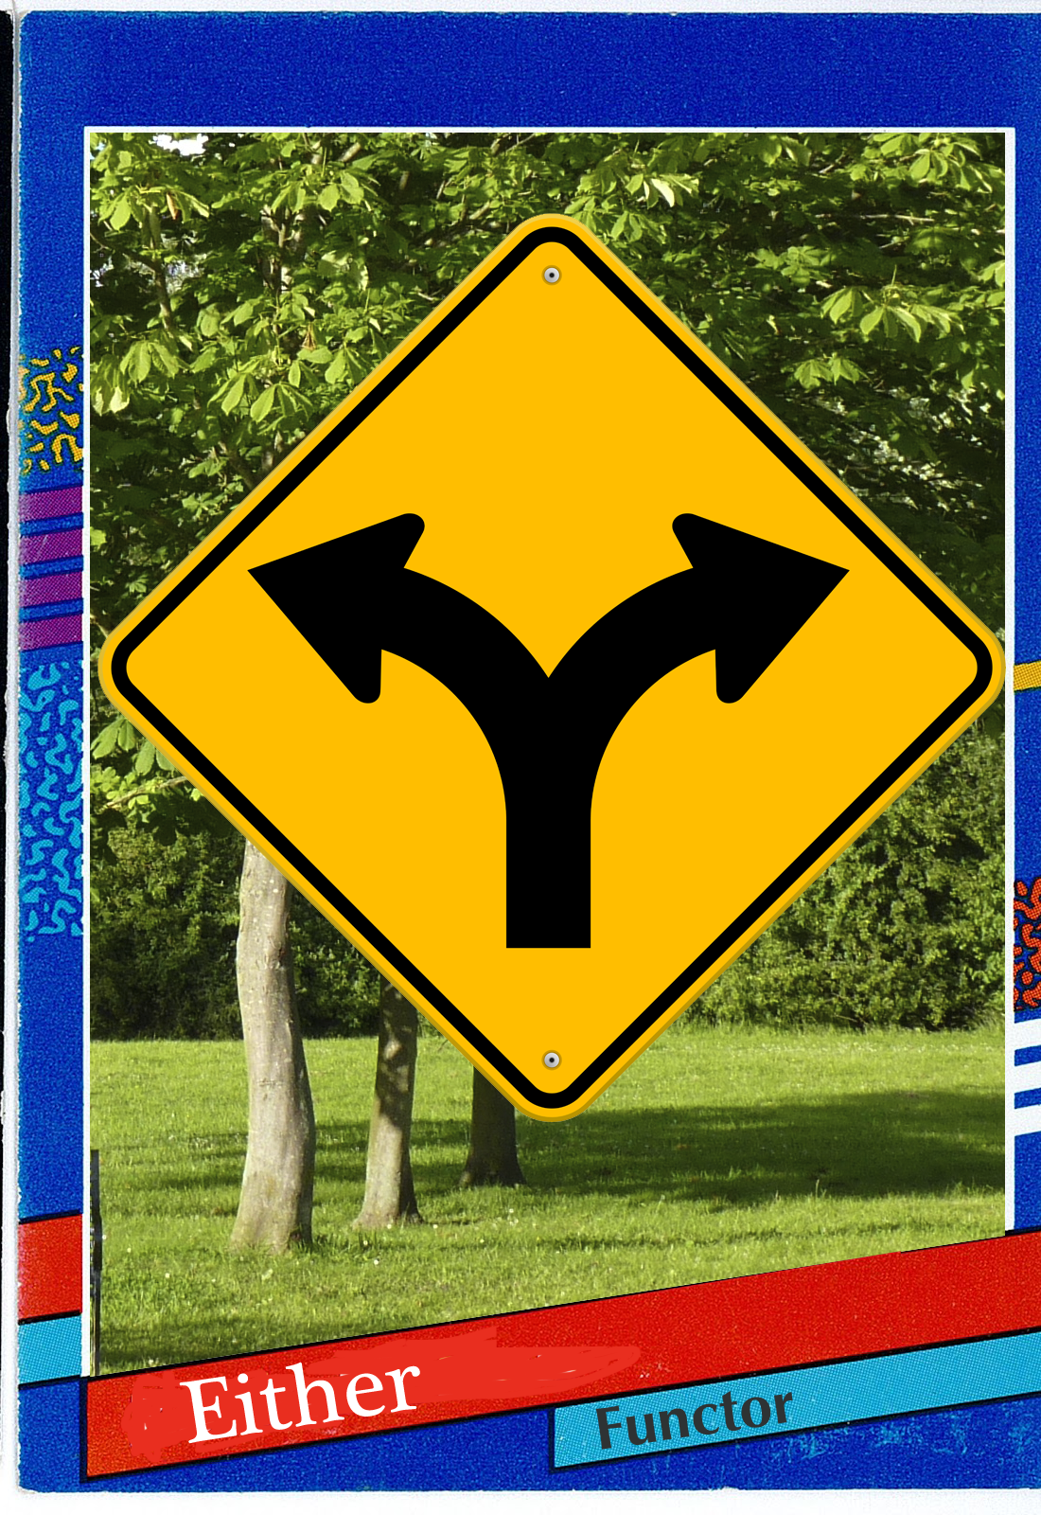
Either
Typically used for pure error handling
Like Maybe, but with an error message embedded
Has two subclasses: Left/Right
Maps the function over a Right, ignores the Left
Notes:
Bored? bitly for cata

Slide 68
Either
map(function(x) { return x + 1; }, Right(2))//=> Right(3) map(function(x) { return x + 1; }, Left(‘some message))//=> Left(‘some message’)
Notes:
Bored? bitly for cata

Slide 69
Notes:
Bored? bitly for cata

Slide 70
Either
var determineAge = function(user){ return user.age ? Right(user.age) : Left("couldn’t get age"); }var yearOlder = compose(map(add(1)), determineAge) yearOlder({age: 22})//=> Right(23) yearOlder({age: null})//=> Left("couldn’t get age")
Notes:
Bored? bitly for cata

Slide 71
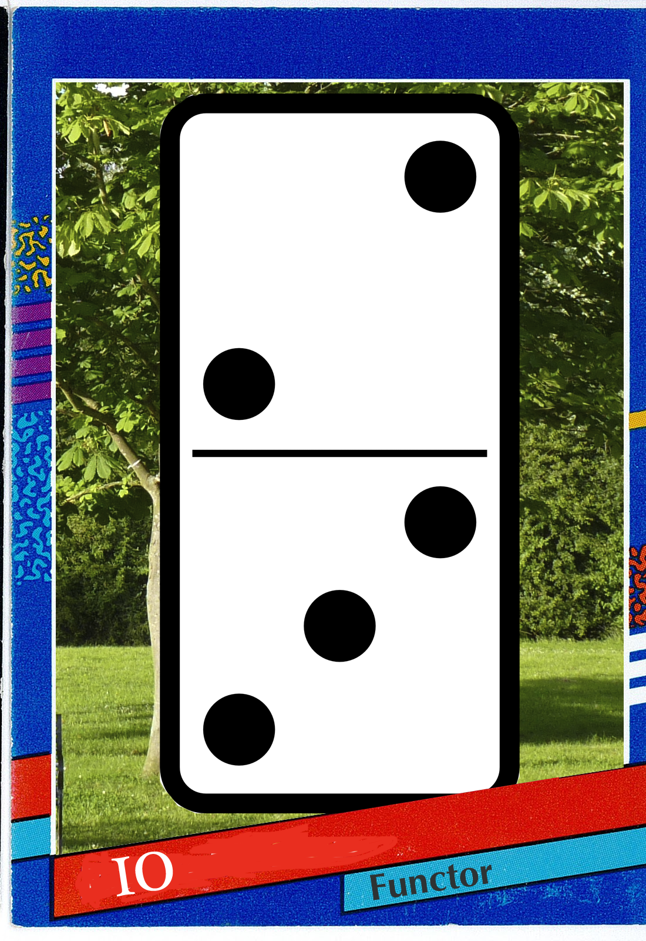
IO
A lazy computation “builder”
Typically used to contain side effects
You must runIO to perform the operation
Map appends the function to a list of things to run with the effectful value.
Notes:
Bored? bitly for cata

Slide 72
IO
var email_io = IO(function(){ return $("#email").val() }var msg_io = map(concat("welcome "), email_io)
runIO(msg_io)
//=> ”welcome steve@foodie.net”
Notes:
Bored? bitly for cata

Slide 73
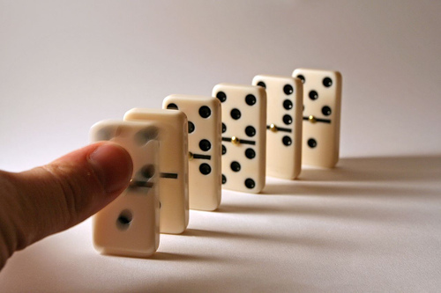
runIO()
Notes:
Bored? bitly for cata

Slide 74
IO
var getBgColor = compose(get("background-color"), JSON.parse)var bgPref = compose(map(getBgColor), Store.get("preferences"))var app = bgPref()
//=> IO()
runIO(app)
//=> #efefef
Notes:
Bored? bitly for cata

Slide 75
IO
var email_io = IO(function(){ return $("#email").val() }
var getValue = function(sel){ return $(sel).val() }.toIO()
http://jsbin.com/zegat
answers: http://jsbin.com/namewuqa
Notes:
Bored? bitly for cata

Slide 76
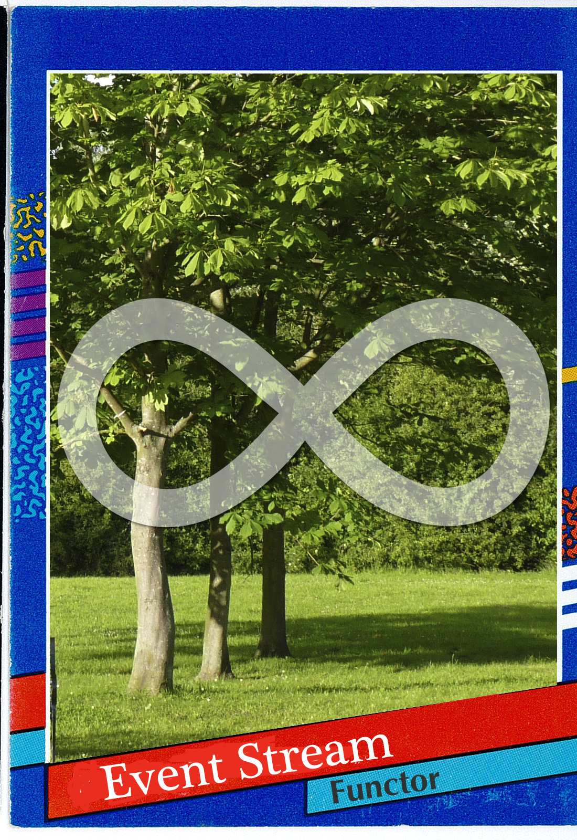
EventStream
An infinite list of results
Dual of array
Its map is sometimes lazy
Calls the mapped function each time an event happens
Notes:
Bored? bitly for cata

Slide 77
EventStream
var id_s = map(function(e) { return '#'+e.id }, Bacon.fromEventTarget(document, "click"))//=> EventStream(String) id_s.onValue(function(id) { alert('you clicked ' +id) })
Notes:
Bored? bitly for cata

Slide 78
EventStream
var id_s = map(function(e) { return '#'+e.id }, Bacon.fromEventTarget(document, "click"))
var element_s = map(document.querySelector, id_s)//=> EventStream(Element) element_s.onValue(function(el) { alert('The inner html is ' +el.innerHTML) })
Notes:
Bored? bitly for cata

Slide 79
EventStream
var hover_s = Bacon.fromEventTarget(document, "hover")var element_s = map(compose(document.querySelector, get('id')), hover_s)var postid_s = map(function(el) { return el.data('post-id') }, element_s)var future_post_s = map(Api.getProductById, postid_s)//=> EventStream(Future(Post))
Notes:
Bored? bitly for cata

Slide 80
EventStream
var hover_s = Bacon.fromEventTarget(document, "hover")var element_s = map(compose(document.querySelector, get('id')), hover_s)var postid_s = map(function(el) { return el.data('post-id') }, element_s)var future_post_s = map(Api.getProductById, postid_s)//=> EventStream(Future(Post))
future_post_s.onValue(alert)
Notes:
Bored? bitly for cata

Slide 81
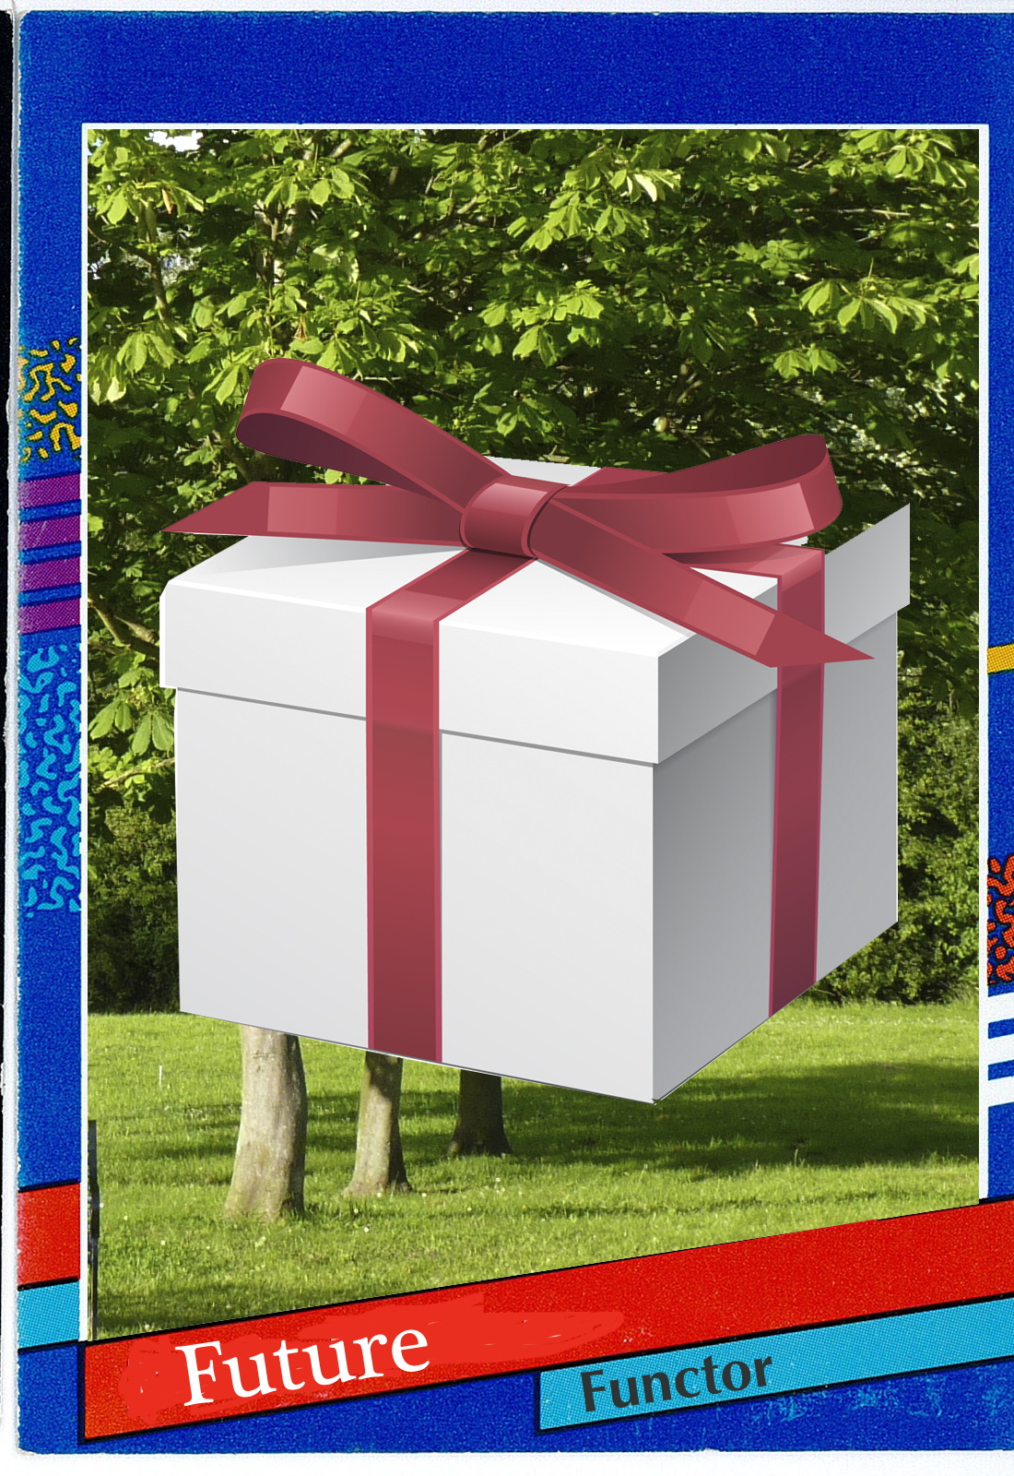
Future
Has an eventual value
Similar to a promise, but it’s “lazy”
You must fork it to kick it off
It takes a function as it’s value
Calls the function with it’s result once it’s there
Notes:
Bored? bitly for cata

Slide 82
Future
var makeHtml = function(post){ return "<div>"+post.title+"</div>"};var page_f = map(makeHtml, http.get('/posts/2')) page_f.fork(function(err) { throw(err) }, function(page){ $('#container').html(page) })
Notes:
Bored? bitly for cata

Slide 83
Future
var makeHtml = function(title){ return "<div>"+title+"</div>"}var createPage = compose(makeHtml, get('title'))var page_f = compose(map(createPage), http.get('/posts/2'))
page_f.fork(function(err) { throw(err) }, function(page){ $('#container').html(page) })
Notes:
Bored? bitly for cata

Slide 84
Future
var lineCount = compose(length, split(/\n/))var fileLineCount = compose(map(lineCount), readFile) fileLineCount("mydoc.txt").fork(log, log)//=> 34
http://jsbin.com/yikoqi
answers: http://jsbin.com/suxemugi
Notes:
Bored? bitly for cata

Slide 85
recognize map
Custom names
We see it is map
[x].map(f) // [f(x)] Maybe(x).attempt(f) // Maybe(f(x)) Promise(x).then(f) // Promise(f(x)) EventStream(x).subscribe(f) // EventStream(f(x))
map(f, [x]) // [f(x)] map(f, Maybe(x)) // Maybe(f(x)) map(f, Promise(x)) // Promise(f(x)) map(f, EventStream(x)) // EventStream(f(x))
Notes:
Bored? bitly for cata

Slide 86
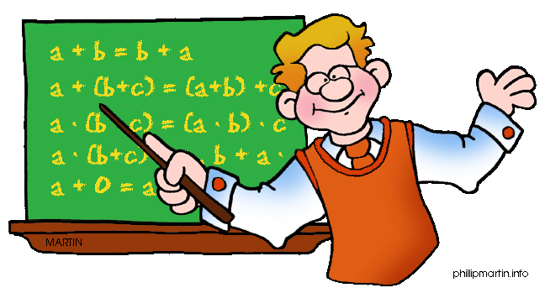
Laws & Properties are useful!

Slide 87
Functor Laws
// identity map(id) == id
// composition compose(map(f), map(g)) == map(compose(f, g))

Slide 88
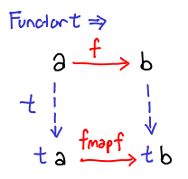
Functors
reverse :: String -> String
toArray :: a -> Array a
var toArray = function (x) { return [x] } compose(toArray, reverse)("bingo")
//=> [ognib]
compose(map(reverse), toArray)("bingo")
//=> [ognib]

Slide 89
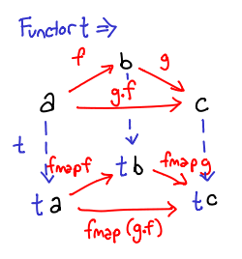
Functors
compose(toArray, compose(toUpper, reverse))("bingo")
//=> [ OGNIB]
compose(map(toUpper), map(reverse), toArray)("bingo")
//=> [OGNIB]
compose(map(compose(toUpper, reverse)), toArray)("bingo")
//=> [OGNIB]

Slide 90
Natural Transformations
nt :: F a -> T a
“Takes one functor to another without knowing anything about the values”

Slide 91
Natural Transformations
maybeToArray :: Maybe a -> Array a
maybeToArray(Maybe(2))//=> [2] maybeToArray(Maybe(null))//=> []

Slide 92
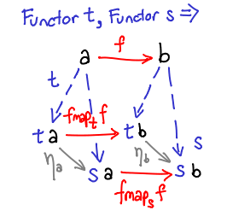
Natural Transformations
compose(nt, map(f)) == compose(map(f), nt)
compose(maybeToArray, map(add(1)))(Maybe(5))// [6] compose(map(add(1)), maybeToArray)(Maybe(5))// [6]

Slide 93
Card Game
Notes:
Bored? bitly for cata

Slide 94
Card Game #1
"Make an api call with an id and possibly retrieve a post"
Notes:
Bored? bitly for cata

Slide 95
Card Game #1
"Make an api call with an id and possibly retrieve a post"
Future(Maybe(Post))
Notes:
Bored? bitly for cata

Slide 96
Card Game #2
"Click a navigation link and insert the corresponding html on the page"
Notes:
Bored? bitly for cata

Slide 97
Card Game #2
"Click a navigation link and insert the corresponding html on the page"
EventStream(IO(Dom))
Notes:
Bored? bitly for cata

Slide 98
Card Game #3
"Submit a signup form & return errors or make an API call that will create a user”
Notes:
Bored? bitly for cata

Slide 99
Card Game #3
"Submit a signup form & return errors or make an API call that will create a user”
EventStream(Either(Future(User)))
Notes:
Bored? bitly for cata

Slide 100
Pointed Functors
of :: a -> F a
aka: pure, return, unit, point

Slide 101
Pointed Functors
Future.of(match(/dubstep/))// Future(match(/dubstep/)) EventStream.of(replace(/dubstep/, 'shoegaze'))// EventStream(match(/dubstep/, 'shoegaze'))
Container.of(split)// Container(split) Maybe.of(reverse)// Maybe(reverse)

Slide 102
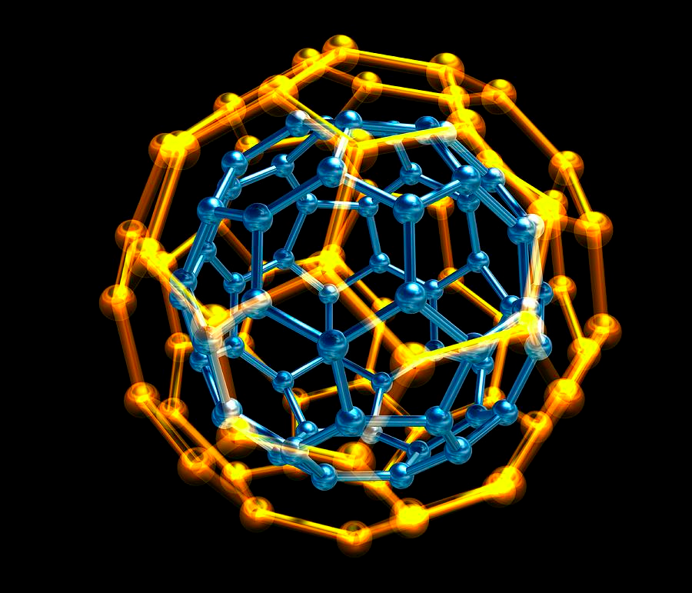
Monads
“Nest computations”
functions: mjoin, chain

Slide 103
Monads
mjoin :: M M a -> M a
chain :: (a -> M b) -> M a -> M b
Pointed Functor + mjoin|chain = Monad
aka: pure, return, unit, point

Slide 104
Monads
mjoin(Container(Container(2)))

Slide 105
Monads
var getTrackingId = compose(Maybe, get("tracking_id"))var findOrder = compose(Maybe, Api.findOrder)var getOrderTracking = compose(map(getTrackingId), findOrder)var renderPage = compose(map(map(renderTemplate)), getOrderTracking)
renderPage(379)//=> Maybe(Maybe(Html))

Slide 106
Monads
var getTrackingId = compose(Maybe, get("tracking_id"))var findOrder = compose(Maybe, Api.findOrder)var getOrderTracking = compose(mjoin, map(getTrackingId), findOrder)var renderPage = compose(map(renderTemplate), getOrderTracking)
renderPage(379)//=> Maybe(Html)

Slide 107
Monads
var setSearchInput = function(x){ return ("#input").val(x); }.toIO()var getSearchTerm = function(){ return getParam("term", location.search) }.toIO()var initSearchForm = compose(map(setSearchInput), getSearchTerm) initSearchForm()//=> IO(IO(Dom))
map(runIO, initSearchForm())

Slide 108
Monads
var setSearchInput = function(x){ return ("#input").val(x); }.toIO()var getSearchTerm = function(){ return getParam("term", location.search) }.toIO()var initSearchForm = compose(mjoin, map(setSearchInput), getSearchTerm) initSearchForm()//=> IO(Dom)
runIO(initSearchForm())

Slide 109
Monads
var sendToServer = httpGet('/upload')var uploadFromFile = compose(mjoin, map(sendToServer), readFile) uploadFromFile("/tmp/my_file.txt").fork(logErr, alertSuccess)

Slide 110
Monads
var sendToServer = httpGet('/upload')var uploadFromFile = compose(mjoin, map(sendToServer), mjoin, map(readFile), askUser) uploadFromFile('what file?').fork(logErr, alertSuccess)

Slide 111
Monads
var chain = function(f) {
return compose(mjoin, map(f))
}
a.k.a: flatMap, bind

Slide 112
Monads
var sendToServer = httpGet('/upload')var uploadFromFile = compose(chain(sendToServer), chain(readFile), askUser) uploadFromFile('what file?').fork(logErr, alertSuccess)

Slide 113
Monads
var sendToServer = httpGet('/upload')
var uploadFromFile = function(what) { return askUser(what).chain(readFile).chain(sendToServer); }
uploadFromFile('what file?').fork(logErr, alertSuccess)

Slide 114
Monads
var chain = function(f) {
return compose(mjoin, map(f))
}
var mjoin = chain(id)
http://jsbin.com/woweg
answers: http://jsbin.com/teholoko

Slide 115
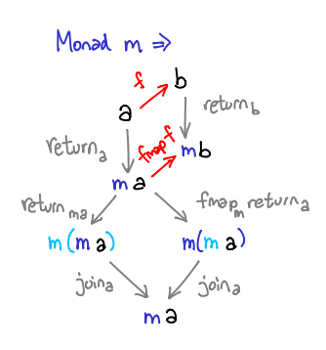
Monads

Slide 116
Monad Laws
compose(mjoin, fmap(g), mjoin, fmap(f))
mcompose(g, f)

Slide 117
Monad Laws
// left identity mcompose(M, f) == f// right identity mcompose(f, M) == f// associativity mcompose(mcompose(f, g), h) == mcompose(f, mcompose(g, h))

Slide 118
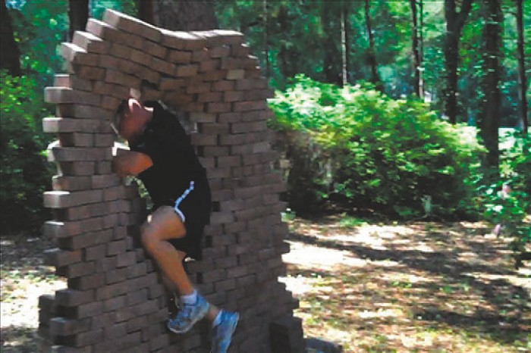
Applicative Functor
“Run full computations in a context”
functions: ap, liftA2, liftA..n

Slide 119
Applicatives
map(add(1), Container(2))//=> Container(3)
map(add, Container(2))//=> Container(add(2))

Slide 120
Applicatives
ap :: A (a -> b) -> A a -> A b
Pointed Functor + ap = Applicative
aka: <*>

Slide 121
Applicatives
Container.of(f).ap(Container(x))//=> Container(f(x))
Container.of(f).ap(Container(x)).ap(Container(y))//=> Container(f(x, y))

Slide 122
Applicatives
Container.of(add).ap(Container(1)).ap(Container(3))//=> Container(4)

Slide 123
Applicatives
Maybe.of(add).ap(Maybe(1)).ap(Maybe(3))//=> Maybe(4) Maybe.of(add).ap(Maybe(1)).ap(Maybe(null))//=> Maybe(null)

Slide 124
Applicatives
var showLoaded = _.curry(function(tweetbtn, fbbtn){ alert('Done!') })
EventStream.of(showLoaded).ap(tweet_btn.on('load’)).ap(fb_btn.on('load’))

Slide 125
Applicatives
var loadPage = _.curry(function(products, reviews){ render(products.zip(reviews) })
Future.of(loadPage).ap(Api.get('/products')).ap(Api.get('/reviews'))

Slide 126
Applicatives
var getVal = compose(Maybe, pluck('value'), document.querySelector)
var save = _.curry(function(email, pass){ return User(email, pass) })
Maybe.of(save).ap(getVal('#email')).ap(getVal('#password'))//=> Maybe(user)

Slide 127
Applicatives
var getVal = compose(Maybe, pluck('value'), document.querySelector)
var save = _.curry(function(email, pass){ return User(email, pass) })
liftA2(save, getVal('#email'), getVal('#password'))//=> Maybe(user)

Slide 128
Applicatives
var getVal = compose(Maybe, pluck('value'), document.querySelector)
var save = _.curry(function(nm, em, pass){ return User(nm, em, pass) })
liftA3(save, getVal('#name'), getVal('#email'), getVal('#password'))//=> Maybe(user)

Slide 129
Applicatives
var loadPage = _.curry(function(ships, orders, receipts){
return render(ships, orders, receipts)
})
liftA3(loadPage, http.get('/shipments), http.get('/orders), http.get('/receipts))
//=> Future(Dom)
http://jsbin.com/zowev
answers: http://jsbin.com/gopemefe

Slide 130
Applicative Laws
// identity A(id).ap(m) == m// composition
A(compose).ap(f).ap(g).ap(w) == f.ap(g.ap(w)))// homomorphism A(f).ap(A(x)) == A(f(x))// interchange u.ap(A(y)) == A(function(f) { return f(y) }).ap(u)

Slide 131
Monoids
“Combination/Accumulation”
functions: mempty, mappend, mconcat

Slide 132
Monoids
reduce(function(acc, x) { return acc + x; }, 0, [1,2,3])

Slide 133
Monoids
reduce(function(acc, x) { return acc * x; }, 1, [1,2,3])

Slide 134
Monoids
reduce(function(acc, x) { return acc || x; }, false, [false, false, true])

Slide 135
Monoids
reduce(function(acc, x) { return acc && x; }, true, [false, false, true])

Slide 136
Monoids
Semigroup:
“Anything that has a concat (combination) method”

Slide 137
Monoids
Monoid:
“Any semigroup that has an empty() method”

Slide 138
Monoids
_Sum = function(v) { this.val = v; }_Sum.prototype.concat = function(s2) { return Sum(this.val + s2.val) }_Sum.prototype.empty = function() { return Sum(0) }

Slide 139
Monoids
Sum(2).concat(Sum(3))//=> Sum(5)

Slide 140
Monoids
Sum(2).concat(Sum(3)).concat(Sum(5))//=> Sum(10)

Slide 141
Monoids
mconcat([Sum(2), Sum(3), Sum(5)])//=> Sum(10)

Slide 142
Monoids
mconcat([Product(2), Product(3), Product(5)])//=> Product(30)

Slide 143
Monoids
mconcat([Any(false), Any(true), Any(false)])//=> Any(true)

Slide 144
Monoids
mconcat([All(false), Any(true), Any(false)])//=> All(false)

Slide 145
Monoids
mconcat([Max(13), Max(2), Max(9)])//=> Max(13)

Slide 146
Monoids
compose(getResult, mconcat, map(Sum))([1,2,3])//=>6

Slide 147
Monoids
compose(getResult, mconcat, map(Any))([false,false,true])//=>true

Slide 148
Monoids
mconcat([toUpperCase, reverse])(["bonkers"])//=> “BONKERSsreknob”
http://jsbin.com/jeqof
answers: http://jsbin.com/mavugozi

Slide 149
Monoids
mconcat([Failure(["message1"]), Success(attrs), Failure(["message2"])])//=> Failure(["message1", "message2"])

Slide 150
Monoids
mconcat([Success(attrs), Success(attrs)])//=> Success(attrs)

Slide 151
Monoids
var checkValidations = mconcat([checkPassword, checkEmail, checkName]) checkValidations({name: "Burt"})//=> Failure([“need a password”, “need an email”])

Slide 152
Monoid Laws
// left identity concat(empty, x) == x// right identity concat(x, empty) == x// associativity concat(concat(x, y), z) == concat(x, concat(y, z))

Slide 153
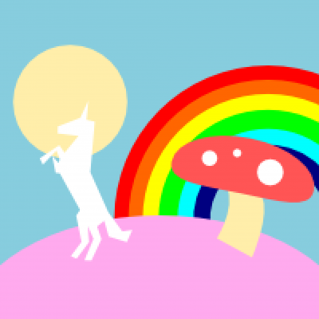
Fantasy Land

Slide 154
End of Part II
The Journey

Slide 155
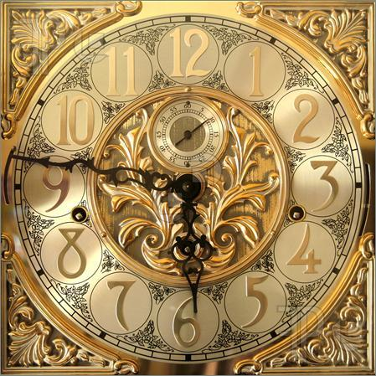
Part III: The Demo

Slide 156
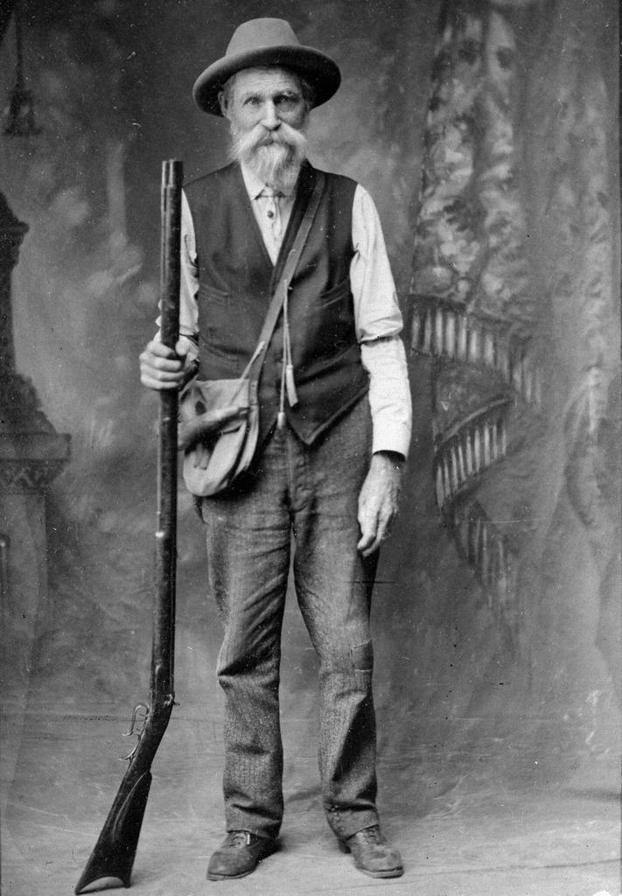
Congratulations!
You’re a pioneer.
These techniques are new to the JavaScript ecosystem.

Slide 157
Libraries are Evolving
We’ll combine the best ones
• CrossEye / ramda
• baconjs / bacon.js
• fantasyland / fantasy-io
• DrBoolean / pointfree-fantasy
• folktale / data.either

